Slide 1
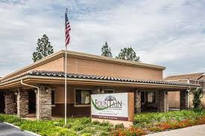
Fountain Senior Assisted Living

Slide 3



Slide 4

What does “Ensign” even mean?

Slide 5

en·sign noun 1. A national flag displayed on ships and aircraft. 2. A standard or banner, as of a military unit. 3. Archaic A standard-bearer.

Slide 6
Our Objective: To be the standard-bearer of senior living and care in the eyes of the world

Slide 7
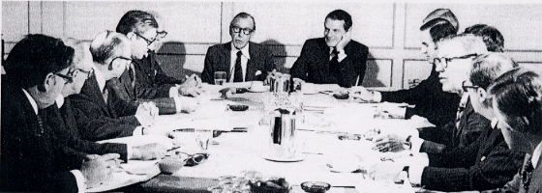
Not “Corporatey”
Notes:
Ask what’s wrong with this model? How does it feel to work at the bottom of this model? We wanted to empower the facility staff to own their facilities and make the important decisions. So we came up with a different model ...

Slide 8
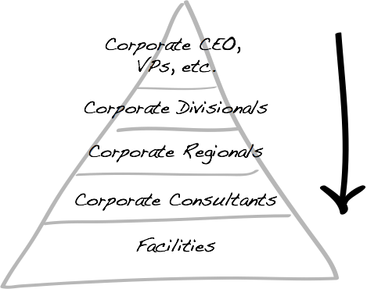
Notes:
Ask what’s wrong with this model? How does it feel to work at the bottom of this model? We wanted to empower the facility staff to own their facilities and make the important decisions. So we came up with a different model ...

Slide 9
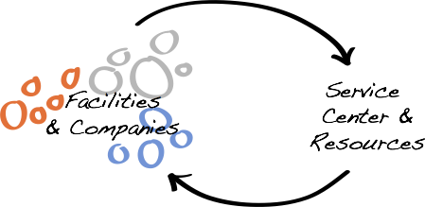

Slide 10
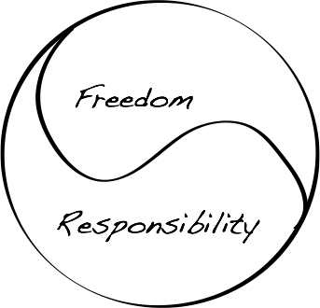

Slide 11
The Service Center

Slide 12
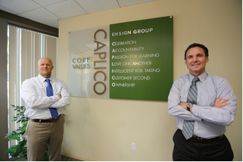

Slide 13
Service Center Mantra: “We’ve Got Your Back.” Accounting Compliance Construction HR IT Legal Payroll

Slide 14
Core Values
CAPLICO

Slide 15
What is CAPLICO?
Each Community has its own unique spirit and personality. You, the employee, are a vital part of that personality. Through CAPLICO we each actively play a role in who we become.

Slide 16
Ensign Core Values
Customer Second
Accountability
Passion for Learning
Love One Another
Intelligent Risk-Taking
Celebration
Ownership

Slide 17
Customer Second

Slide 18
Customer 2nd = Employee 1st = Resident 1st

Slide 19
Moments of Truth

Slide 20
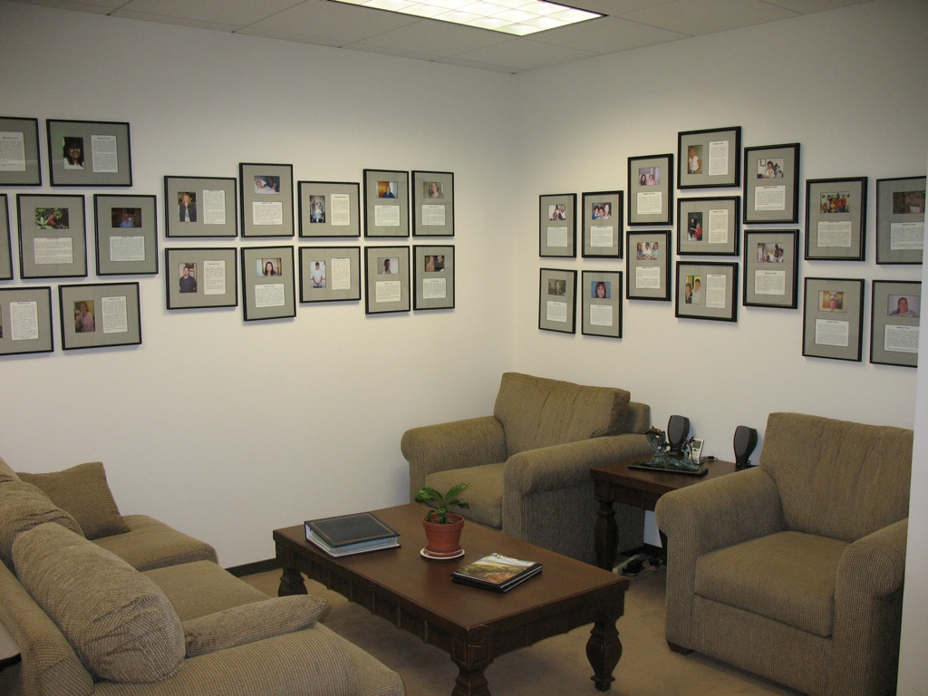
Notes:
Be looking for moments of truth from partners. We’re so lucky that we get to work in this sort of environment. We’re around patients and family members have serious needs. They’re scared about what’s going on. All sorts of opportunities. Celebrate them. Look for them.

Slide 21

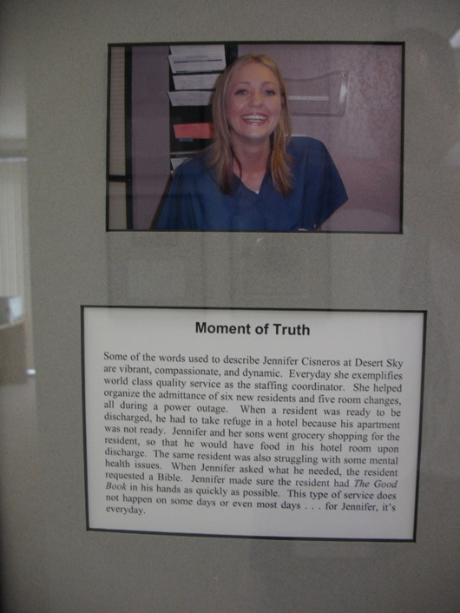

Slide 22
Accountability

Slide 23
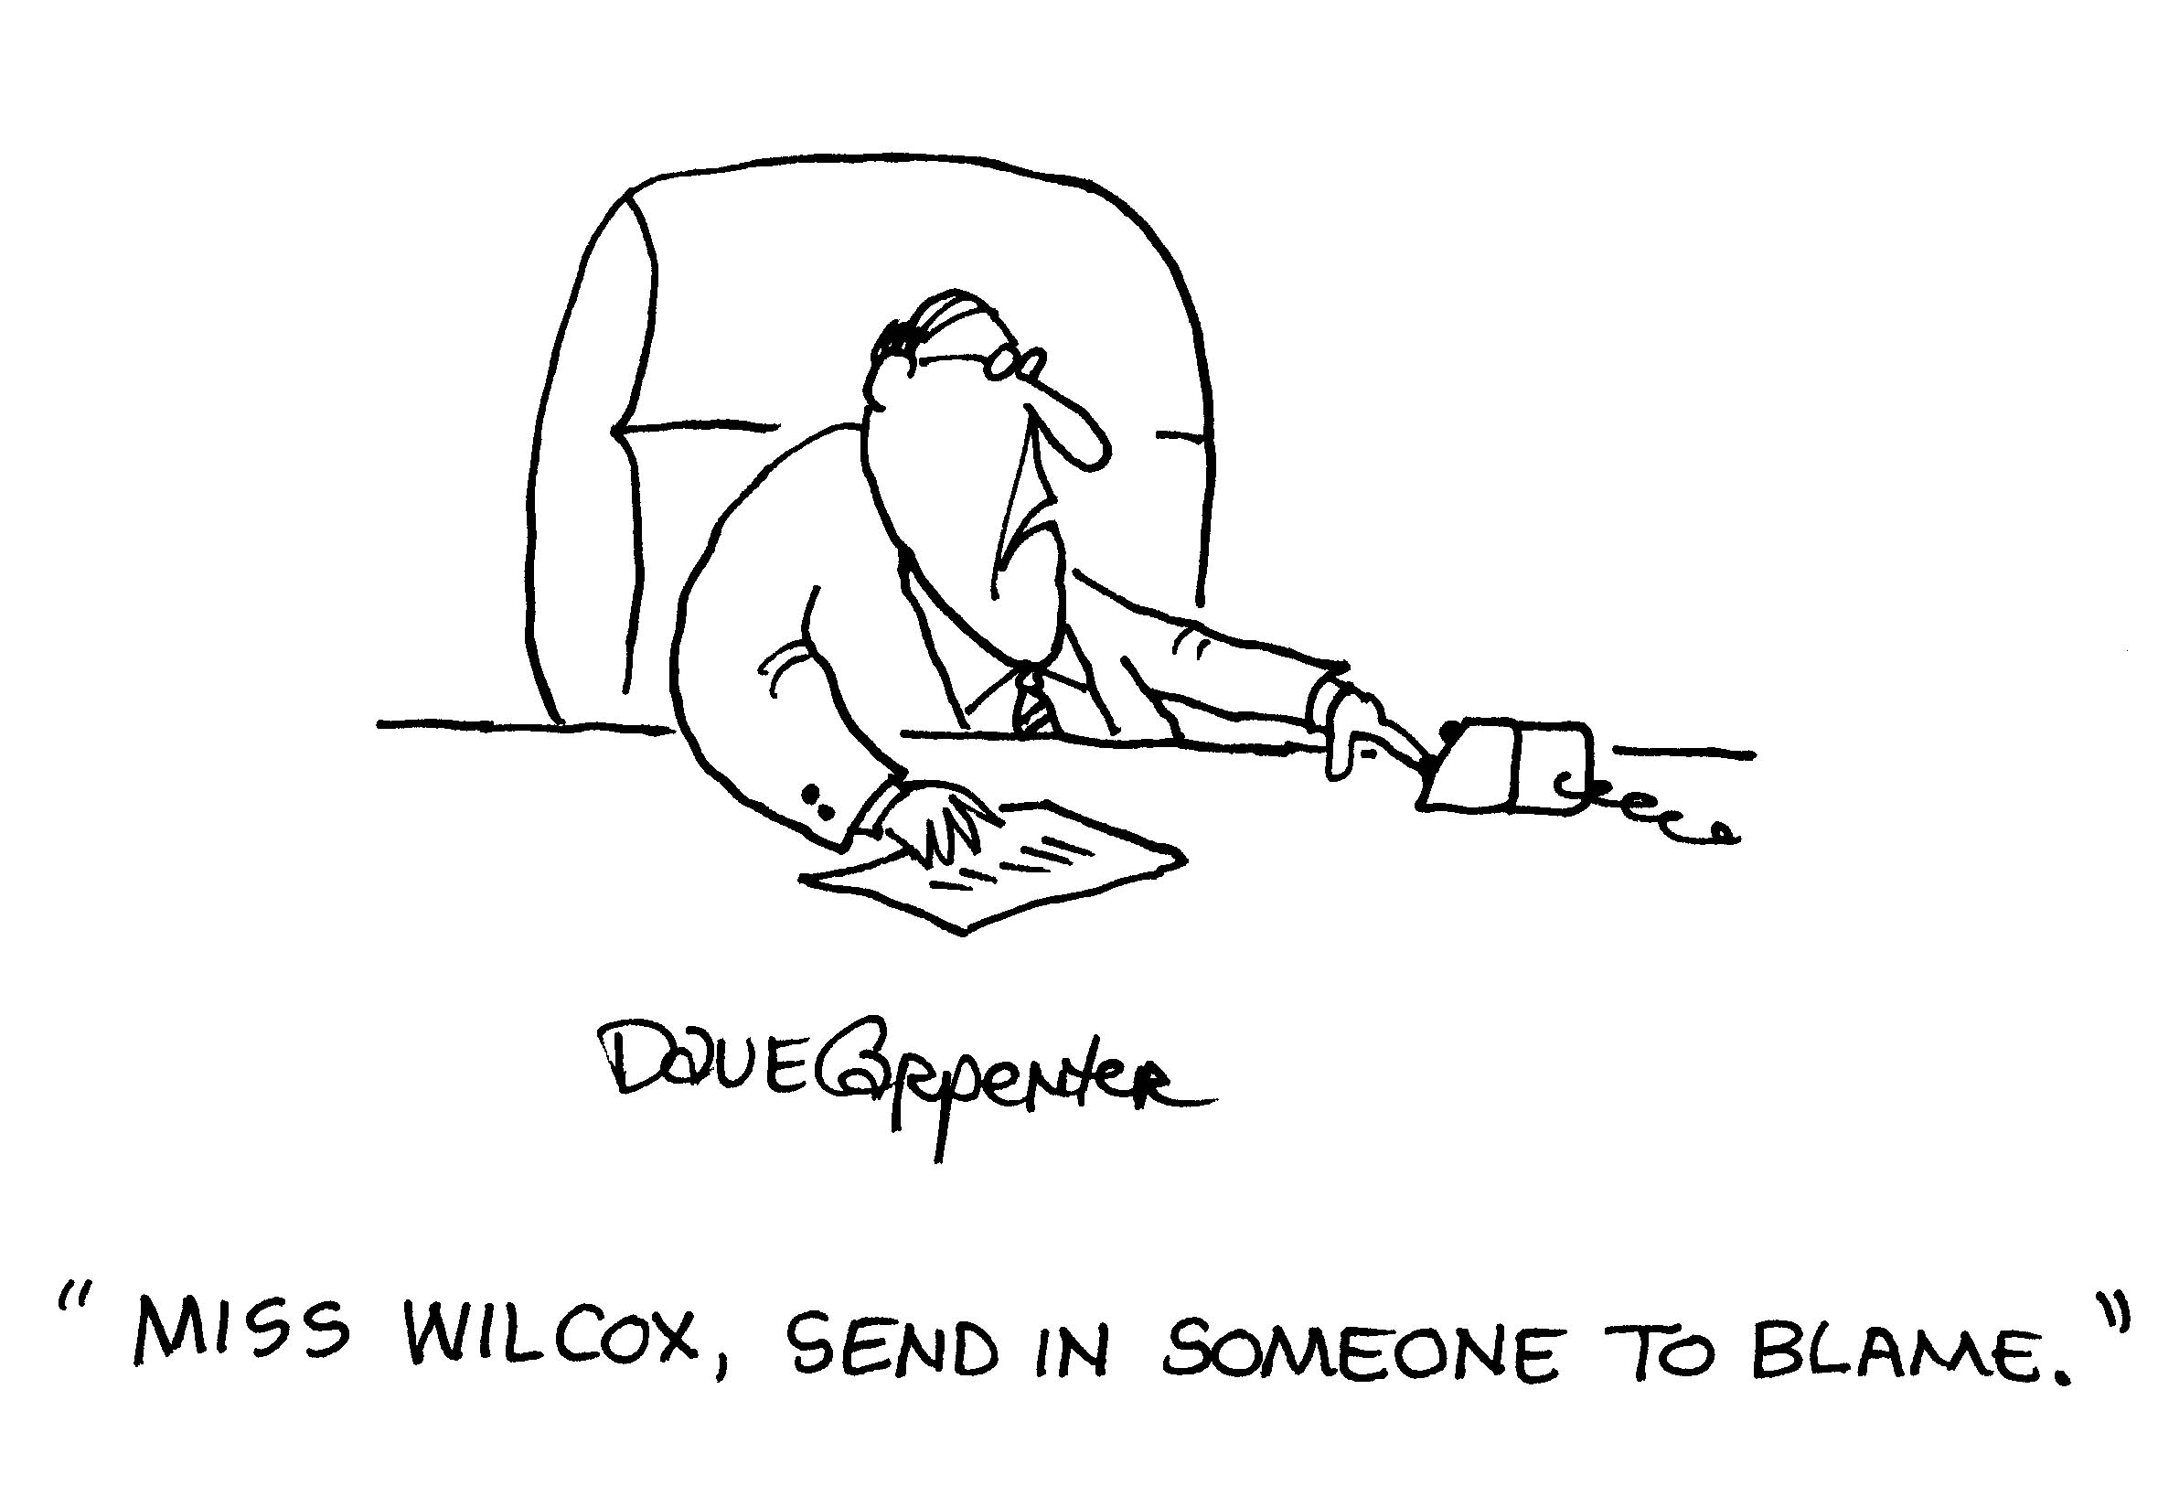

Slide 24
Creating a Culture of Accountability:
We are decisive and hold ourselves accountable.
We take correction easily.
We take responsibility
(when we blow it, we admit we blew it and we fix it).

Slide 25
Passion for Learning

Slide 26

We actively both
learn & teach

Slide 27
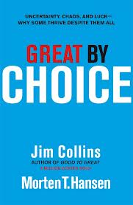

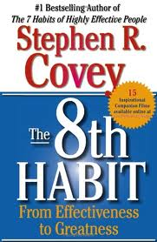
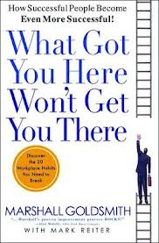
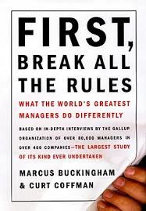
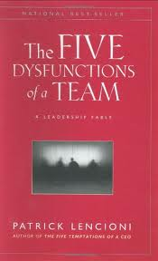
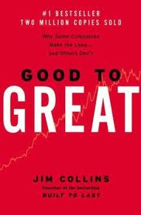
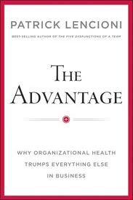

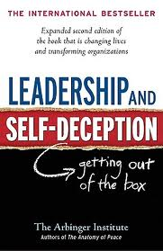



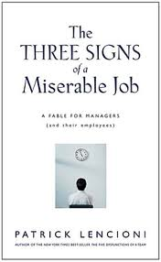
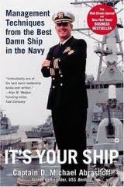

Slide 28
Love One Another

Slide 29
We always
treat others
with kindness,
even when
confronting the
brutal facts.

Slide 30

One way we Love One Another

Slide 31
A social services employee and mother of a 3-month-old infant and 3 older children lost her condo to fire. Nearly all the family’s possessions were damaged or destroyed. The fund helped them get back on their feet.
An LPN underwent risky brain surgery to remove a tumor. The fund helped with expenses related to an extended hospital stay.
The 11-year-old son of a CNA was hit by a truck and killed while riding his bicycle. The fund assisted with funeral expenses in the wake of the devastating loss.

Slide 32
Intelligent Risk Taking

Slide 33
Cluster Model
Notes:
One example of an intelligent risk. Some companies would think we’re crazy for doing something like that. Clusters work in groups and hold each other accountability to eliminate regionals and corporate. Willing to take risks if it’s going to create better outcomes.
How clusters work. Be asked to help other buildings to teach what doing so well.

Slide 34
Celebration

Slide 35
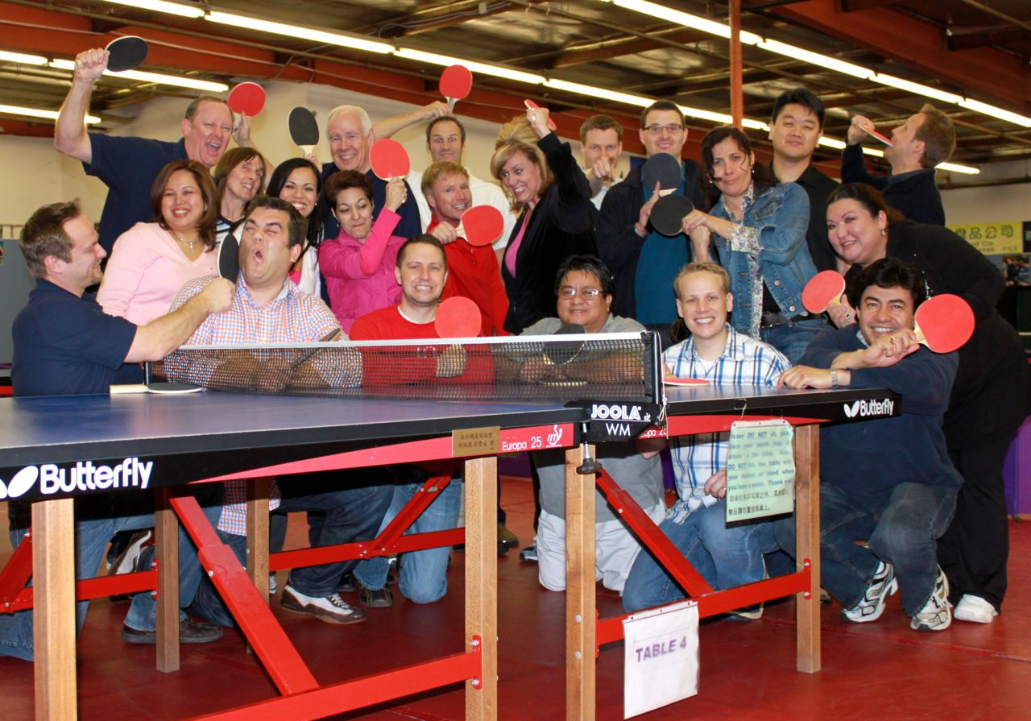
We celebrate success…

Slide 36
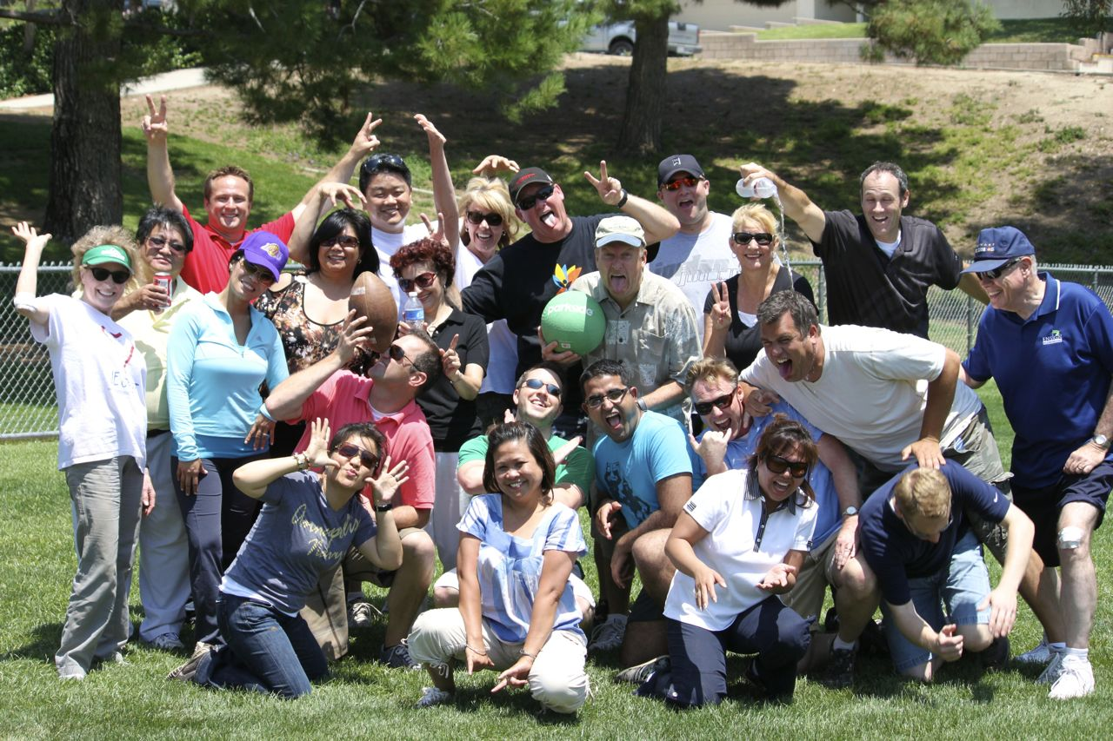
…as we recognize & appreciate the contributions of others.

Slide 37
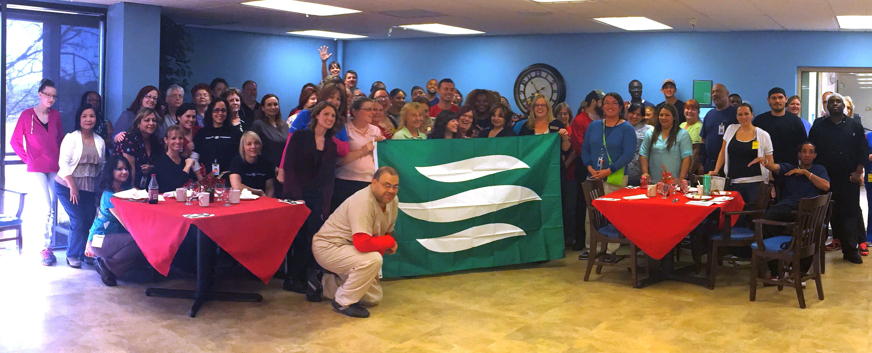
The Flag

Slide 38
Flag Criteria
Excellent Clinical and Survey Results
Achieve BHAG
Amazing facility team culture
Moments of Truth
Physical appearance and first impressions

Slide 39
Criteria (continued)
Employee, Patient and Family Satisfaction Scores
Employee Safety
Cash Collections
Occupancy – Average 90% OR 10% above prior year during Flag Period
Excellent Compliance results

Slide 40
Flag Award
Party and Award Ceremony
Honor of being a Flag Flying Facility for a year
ALF Cash Prize = $ per occupied bed paid 50% to employees and 50% for Capital Expenditures

Slide 41
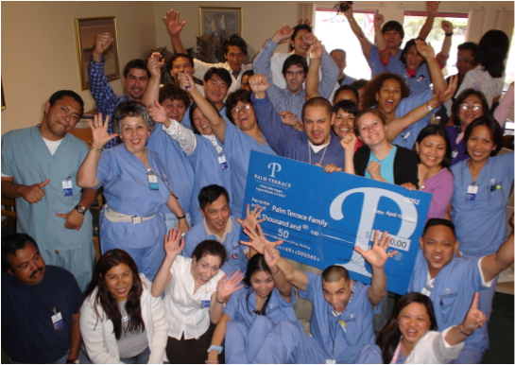

Slide 42
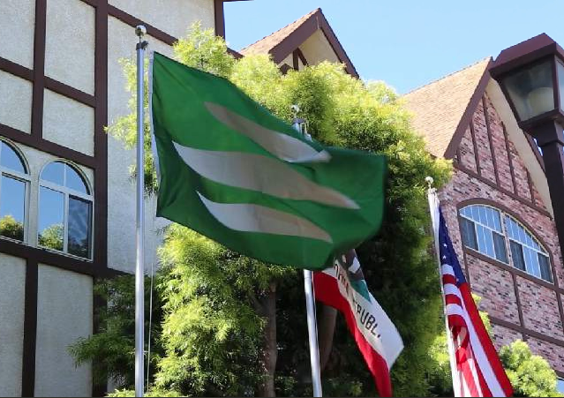
Who wants it?

Slide 43
Ownership

Slide 44
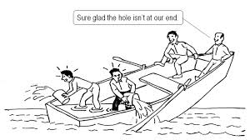

Slide 45
Quiz
What hangs on the walls of the Service Center?

Slide 46
Quiz
Moments of Truth

Slide 47
Quiz
What is the name of the program of how we take care of our fellow employees?

Slide 48
Quiz

Slide 49
Quiz
What is the highest facility award in Ensign?

Slide 50
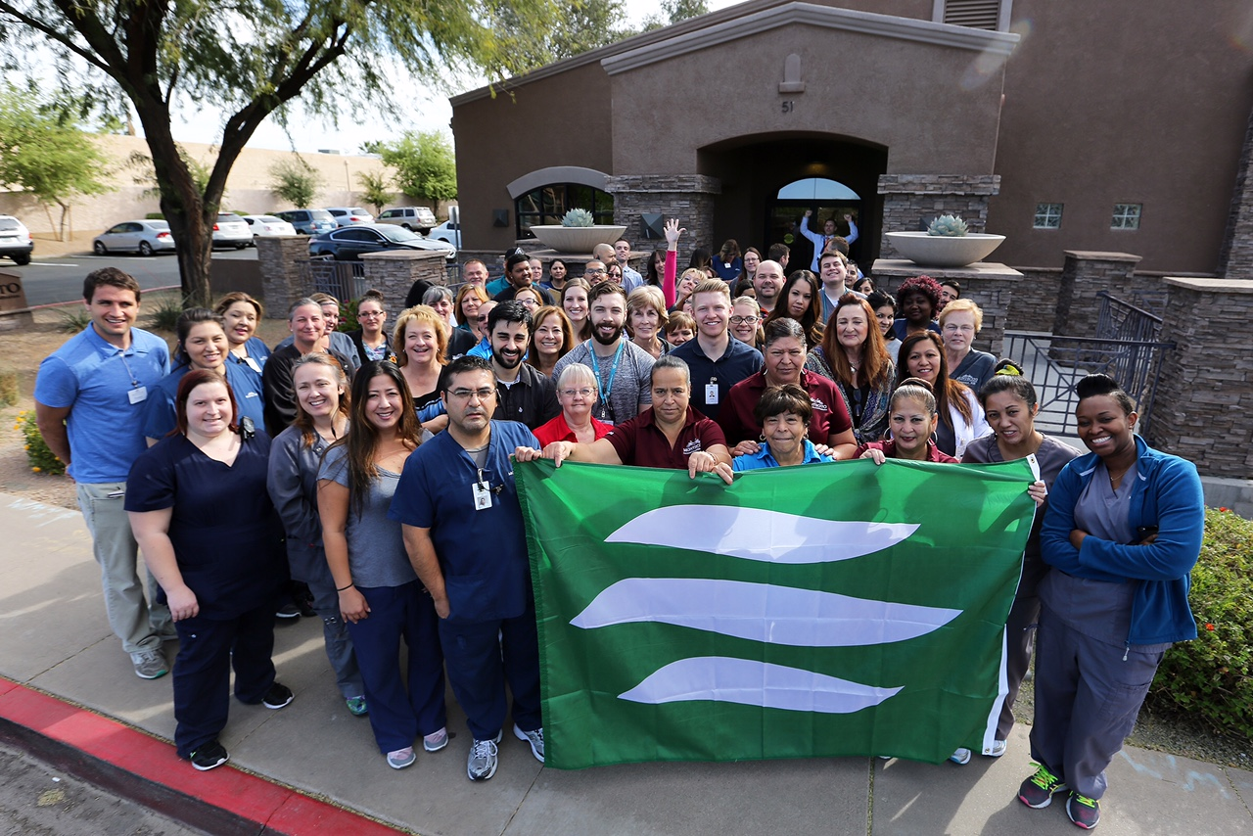
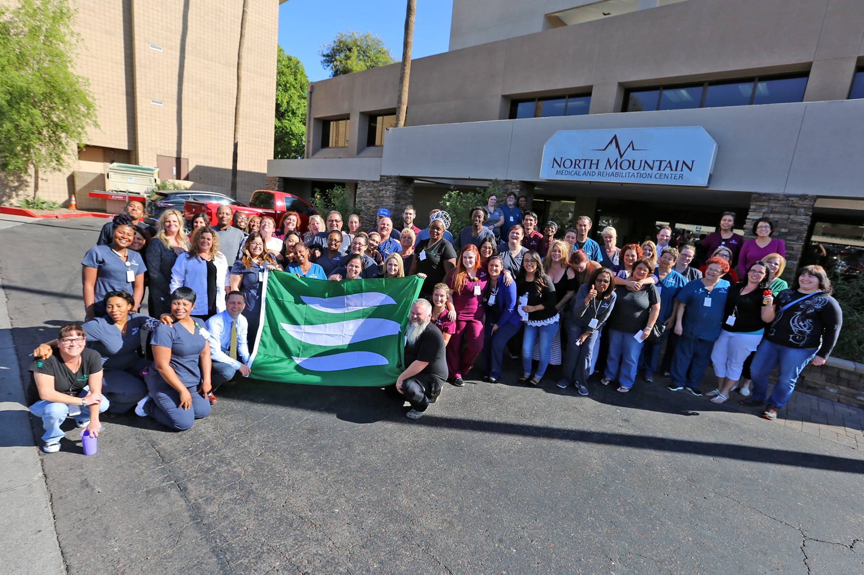
Quiz
The Flag

Slide 51
LAST QUESTION:
Can you name the Core Values?

Slide 52
Answer
Customer Second
Accountability
Passion for Learning
Love One Another
Intelligent Risk-Taking
Celebration
Ownership

Slide 53
QUESTIONS?
Fountain Senior Assisted Living

